Slide 1
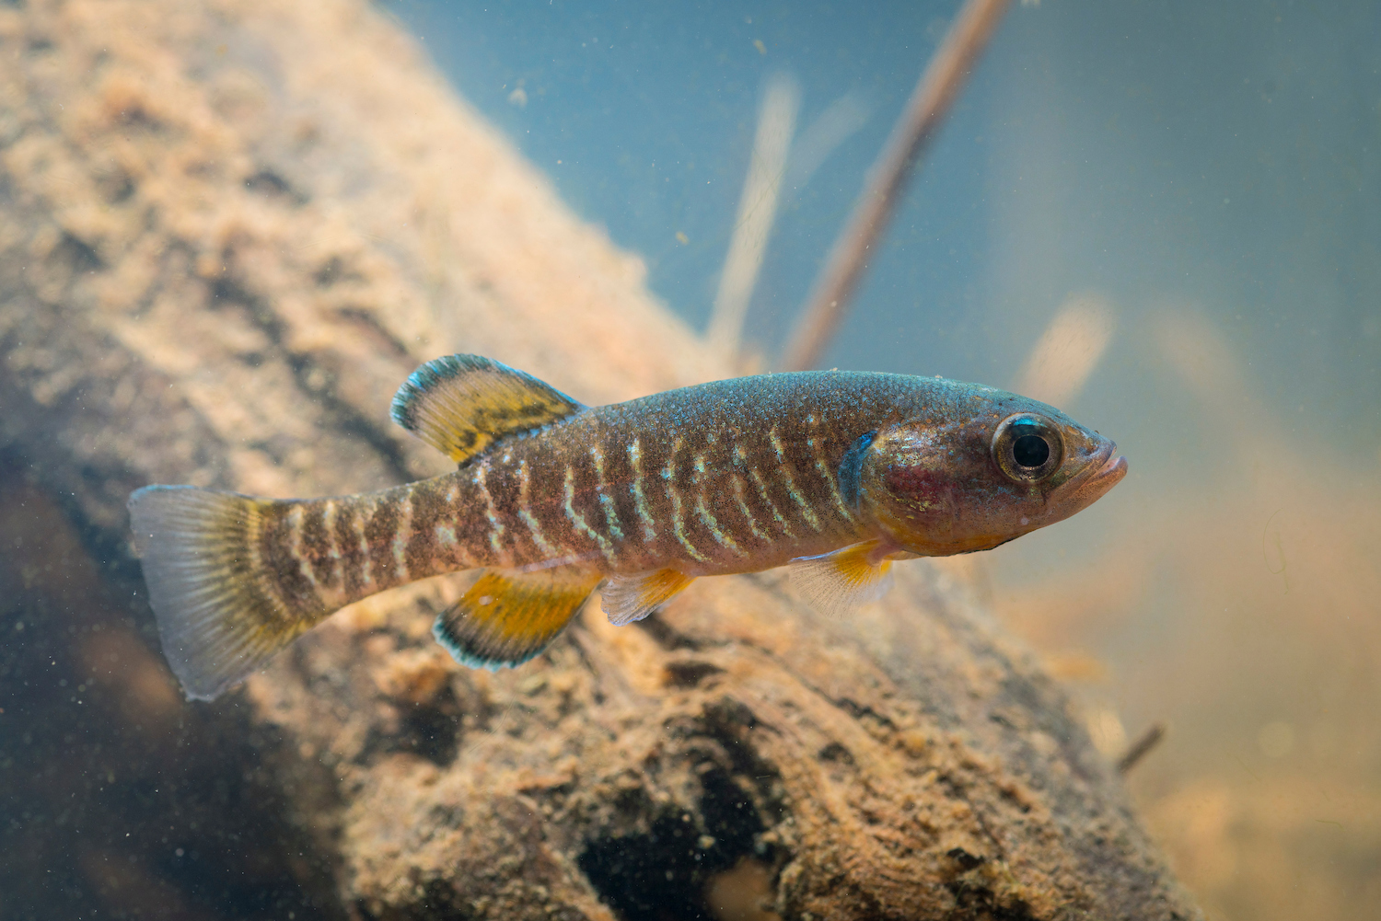
First otolith analysis of age and growth in Olympic Mudminnows (Novumbra hubbsi), a Washington State endemic
Kim Kidder

